Slide 1
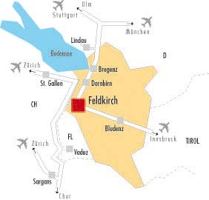
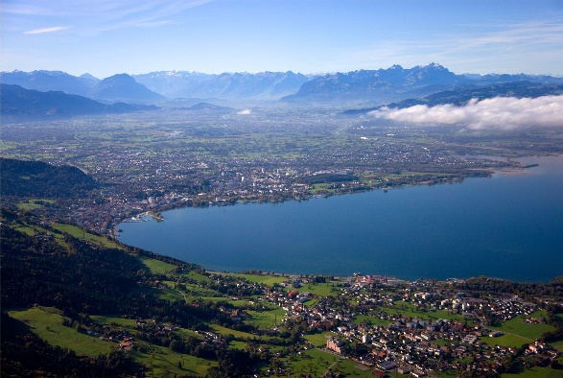
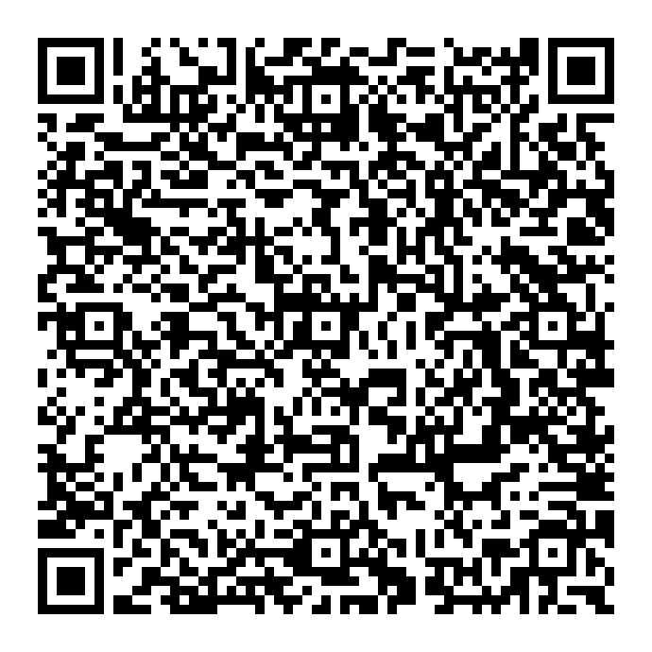
Contact:
The JCI CREED
Chamber of Commerce Vorarlberg
Department Junge Wirtschaft:
E-Mail: info@jwv.at
Fon: +43 5522 305-0
The Jaycee Creed was written by C. William Brownfield in 1946. Adopted by the U.S. Junior Chamber and Junior Chamber International, this simple statement of beliefs unites Jaycees around the world in a bond of friendship and purpose. These 65 words have become the third most important document in the lives of many, many people worldwide.
We believe:
That faith in God gives meaning and purpose to human life; That the brotherhood of man transcends the sovereignty of nations; That economic justice can best be won by free men through free enterprise; That government should be of laws rather than of men; That earth's great treasure lies in human personality, And that service to humanity is the best work of life.
European JCI Senators’
SUMMIT
THE FUTURE OF EUROPE
By car: Address: 6800Feldkirch, Wichnergasse
By train Feldkirch mainstation
By plane
Local airports: Rheinthal (15min.), Friedrichshafen (40min) or Innsbruck (2h)
Int. Airport: Zürich (1,5h)
Hotel recommendations
Gutwinski Löwen Cenral Leonhard Hostel
April 5th.-9th. 2018
«Welcome to the Rhein Valley»

Slide 2
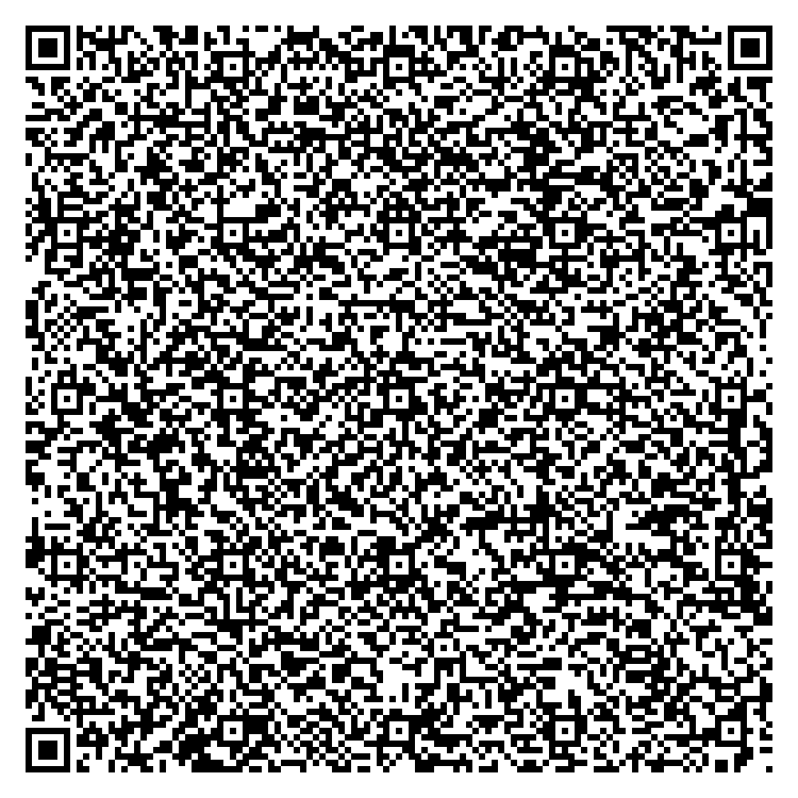
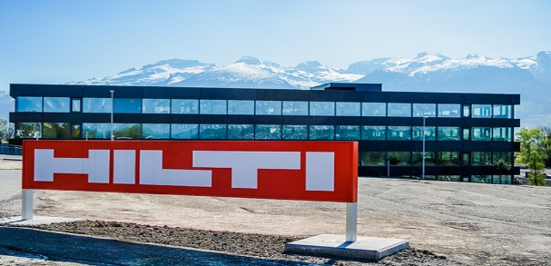
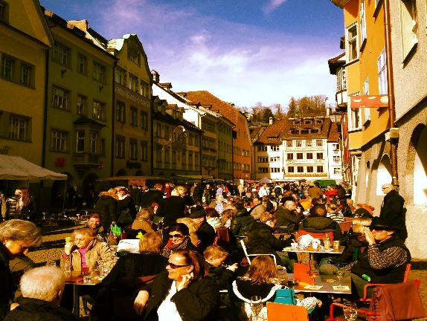
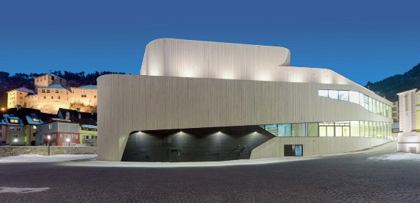
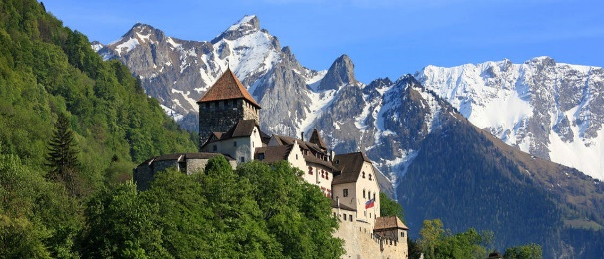
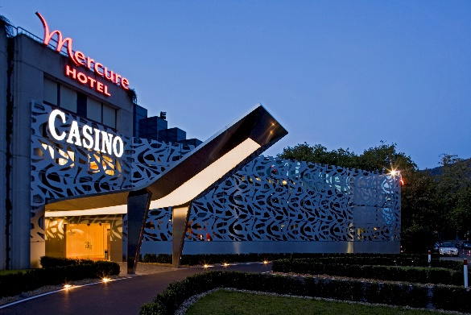
PROGRAMME
PROGRAMME
April, 6th. 08:30 Transportation to Hilti AG, FL
09:00 Welcome at Hilti AG in Schaan/ FL
Company Visit
10:30 Summit Workshop „Little Picture“
13:00 Transportation to Vaduz/ FL
13:30 Lunch in Vaduz/Liechtenstein
15:00 Sightseeing-Tour Vaduz and Press Conference about the Summit Workshop
17:00 Transportation to Feldkirch
20:00 Joint Dinner, Feldkirch/Austria
22:00 Senate Bar
PROGRAMME
April, 7th.
09:00 ASE Board Meeting, Feldkirch
Presenting the Result
12:00 Lunch in Feldkirch/Austria
14:00 Afternoon programme/free
19:00 Gala Dinner & Casino in Bregenz
Open end
April, 8th.
09:00-12:00 Farewell in Feldkirch
April, 4th. 07:45 Transportation Golfers only Gams/ CH
09:00 Senators Golf Competition Gams/CH
19:00 Welcome Dinner, Feldkirch/AUT
21:30 Senate Bar
April, 5th. 09:00 Opening of the Senators Summit 2018 Feldkirch/ AUT
09:30 Summit Workshop “Team Europe”
12:00 Lunch
13:30 Summit Workshop “Big Picture”
18:00 Closing of the Big Picture Workshop
19:30 Keynote Speech & Dinner Presented by Junge Wirtschaft Vorarlberg

